Slide 1
Presentation on class and objects
Narala Praveen’s

Slide 2
Agenda
To explain the concepts of class and object with real time example.

Slide 3

What is a class?
A class is a user-defined blueprint (or) prototype from which objects are created.
Basically ,a class combines the fields and methods (member functions which defines actions) into a single unit. In c# ,classes support Polymorphism, inheritance and also provide the concept of derived classes and base classes.
A class is not a real world entity.

Slide 4

What is a object ?
Object is a real world entity, In other words object is an entity that has state and behaviour.
Here state means data and behaviour means functionality . Object is a realtime entity, it is created at runtime.

Slide 5
For example bike is a class and the brands and models of bikes are objects of the bike class.

Slide 6
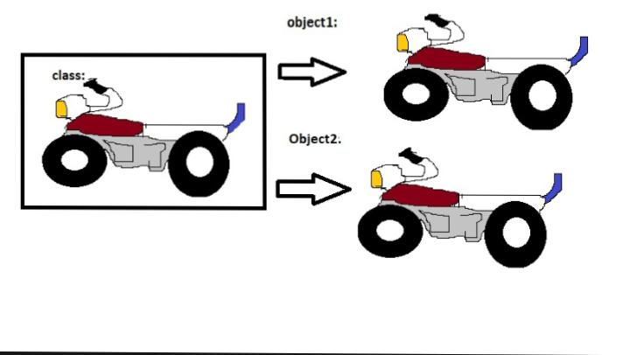

Slide 7
For example pet animals is a class In pet animals class dog is one object and cat another object .

Slide 8


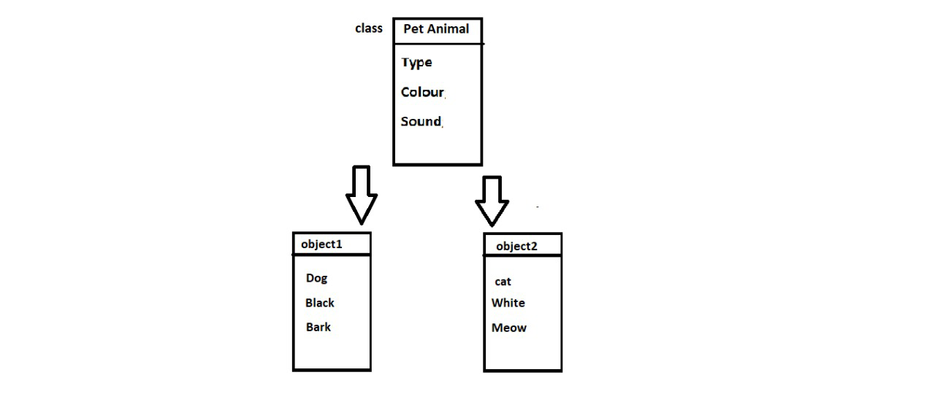
public class PetAnimals

Slide 9
Thank you

